Slide 1

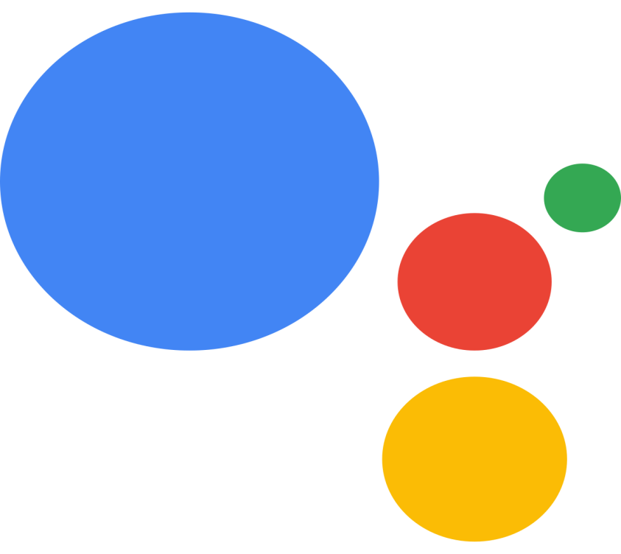
GOOGLE ASSISTANT
Department Of Computer Science & Electronics Engineering
PRESENTED BY :
Anushka Vyas
Kiran Gupta

Slide 2
CONTENT
INTRODUCTION
HOW IT WORKS?
TECHNOLOGIES USED
FEATURES
ADVANTAGES
DISADVANTAGES
FUTURE SCOPES
CONCLUSION

Slide 3
Introduction
Google Assistant is an Artificial Intelligence powered virtual assistant developed by Google i.e. primarily available on mobile and smart home devices.
It is a voice-enacted remote helper, first presented by Google at the 2016 I/O meeting in California.

Slide 4
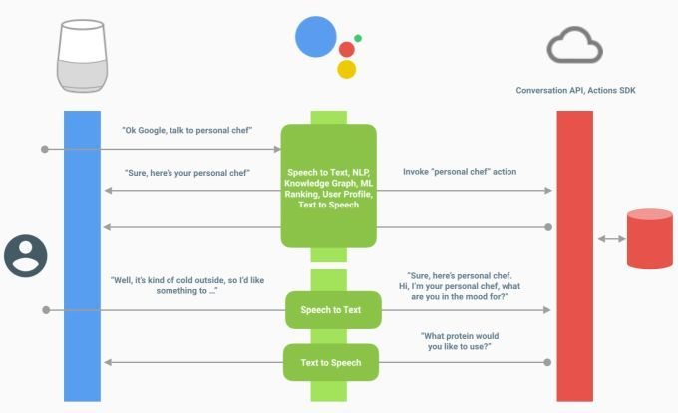
How It Works?

Slide 5

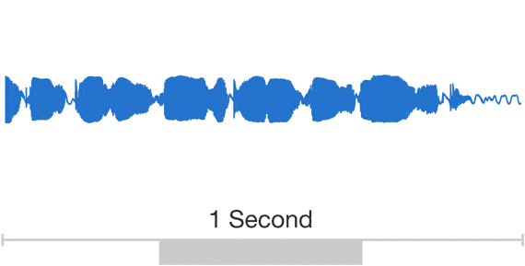
Technologies Used
NATURAL LANGUAGE PROCESSING
WAVENET

Slide 6
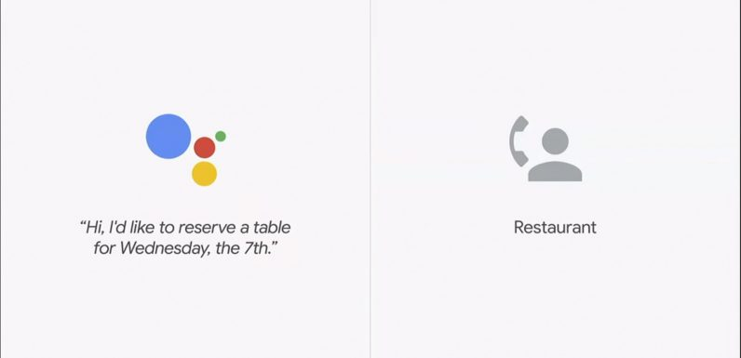
Technologies Used
GOOGLE DUPLEX

Slide 7
Features
Control your gadgets and your smart home.
Get to data from your schedules and other individual data.
Play content on your Chromecast or other good gadgets.
Peruse your notices to you.
Run clocks and updates.

Slide 8
Advantages
Simply state what you need.
It can translate any language out there.
It can peruse your morning news for you.
Can control applications.
Helps in keeping up your spirits.

Slide 9
Disadvantages
It expects clients to offer access to a ton of information.
You will feel like you are observed constantly.
It can access all your personal data to convey your request.

Slide 10
Future Scopes
Increasingly Personalized Responses With Contextual Understanding.
Individualized Experiences.
Touch Interaction.
Security.
Beyond the mobile phones.
It would be beneficial for blind people.

Slide 11
CONCLUSION
Google Assistant is a conversational way to interact with user to share or generate the output according to the user’s need by only speaking.
It is not only able to search information from internet but also can schedule events and alarms and can adjust hardware settings on the user’s device.

Slide 12
Thank You

